Slide 1

Exercise -3.2
Nature of roots and Nature of coefficients

Slide 2




Exercise -3.2
1. If k is real, discuss the nature of the roots of the polynomial equation 2x + kx + k = 0, in terms of k
2
Solution:-
Step 1:
Identify coefficients.
Step 2:
Find discriminant
Step 3:
Substitute values.

Slide 3

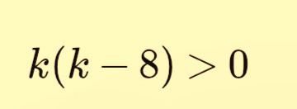
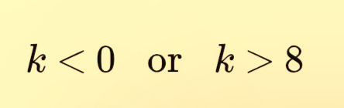


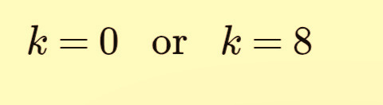
Step 4:
Factorize
Step 6:
Case 1:
Then
Roots are real and distinct.
Step 7:
Case 2:

Slide 4



Then
Roots are real and equal.
Step 8:
Case 3:
Then
Roots are imaginary.

Slide 5
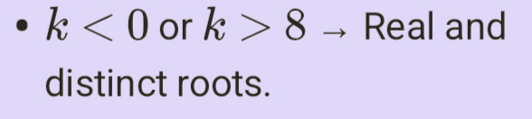
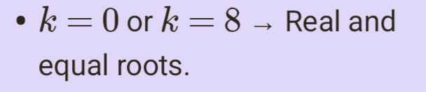

Answer:
Division

Slide 6
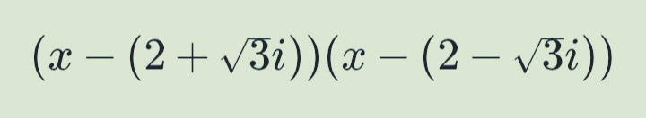
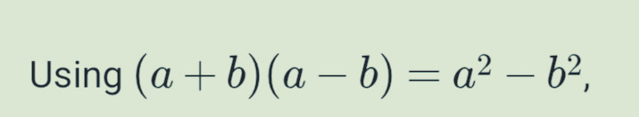

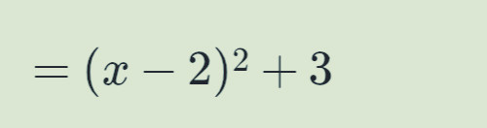
2.Find a polynomial of minimum degree with rational coefficients having 2 + √3i as a root.
Solution:-
Step 1:
Since coefficients are rational, is 2 - √3i also a root.
Step 2:
Form the Polynomial:
Step 3:
Use identity

Slide 7


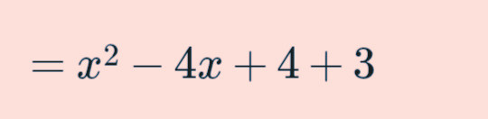
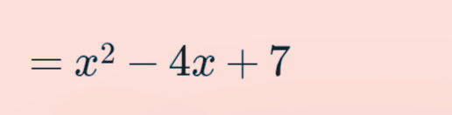


Step 4:
Step 5:
Expand
Answer-

Slide 8
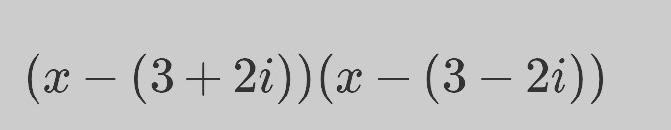
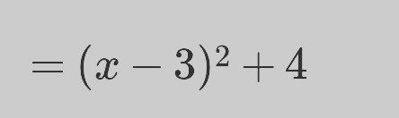
3. Find a polynomial of minimum degree with rational coefficients having 3+2i as a root.
Solution:-
Step 1:
Conjugate root:
3 - 2i
Step 2:
Form the Polynomial
Step 3:
Apply identity.

Slide 9



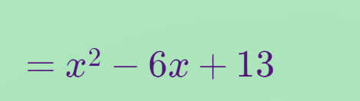

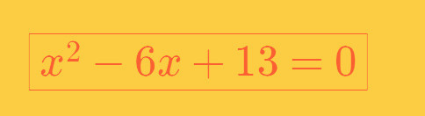
Step 4:
Step 5:
Expand
Answer-

Slide 10



4. Find a polynomial equation of minimum degree with rational coefficients, having √5-√3 as a root.
Solution :-
Step 1:
Let
Step 2:
Square both sides.
Step 3:
Expand.

Slide 11




Step 4:
Rearrange
Step 5:
Square again.
Step 6:
Expand.

Slide 12


Step 7:
Bring all terms to one side.
Answer-

Slide 13
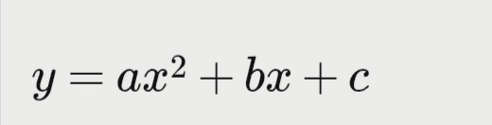
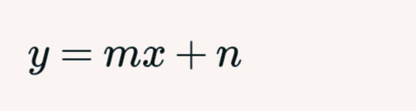
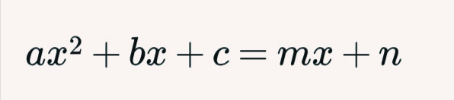
5.Prove that a straight line and a parabola cannot intersect at more than two points.
Solution:-
Step 1:
Take the parabola.
Step 2:
Take the straight line.
Step 3:
Substitute

Slide 14
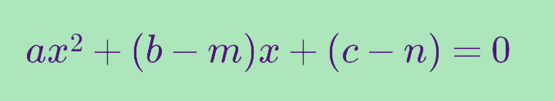

Step 4:
Bring all terms to one side.
Step 5:
This is a quadratic equation in x.
Step 6:
A quadratic equation can have at most two roots.
Step 7:
Therefore, there can be at most two common
points.
Answer- A straight line and a parabola cannot intersect
at more than two points.

